Slide 1
CPSC552: Lab 2 Report
Weifeng Li
0984558

Slide 2
Objectives
Implementation of data mining algorithms
Gain experience with clustering algorithms

Slide 3
Issues
Understanding of Algorithms
Data generating and organization
Detail orientation
Visualization

Slide 4
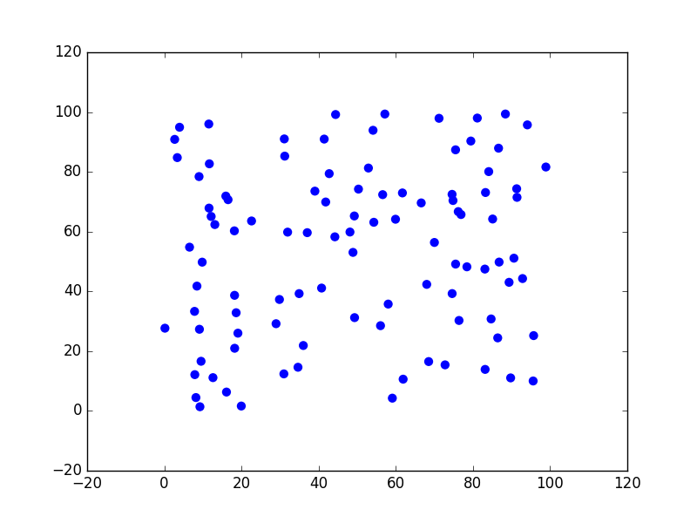
Data Sets
Data Set 1: Random

Slide 5
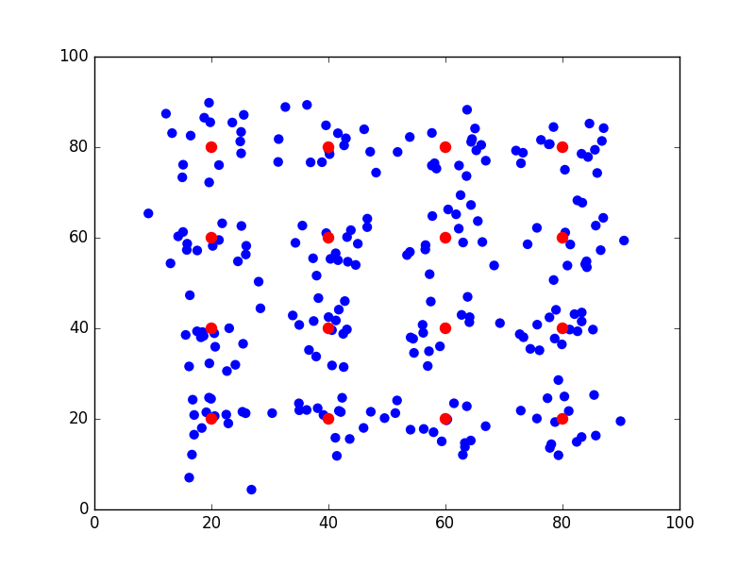
Data Sets
Data Set 2: Gaussian

Slide 6
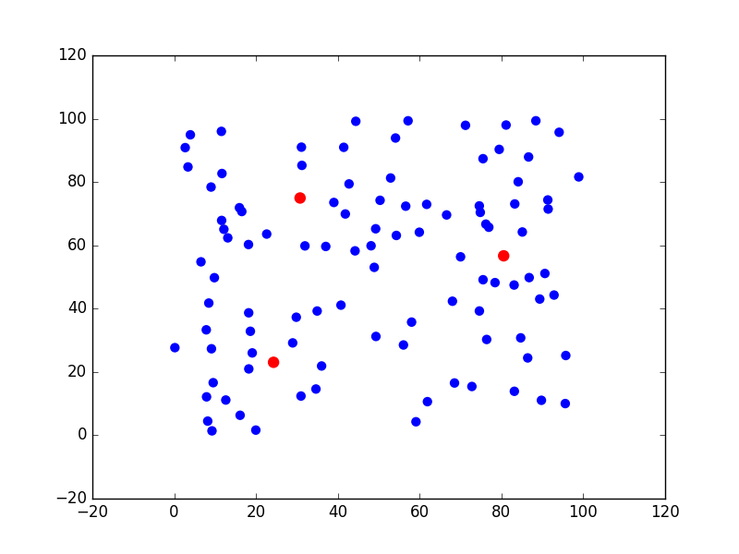
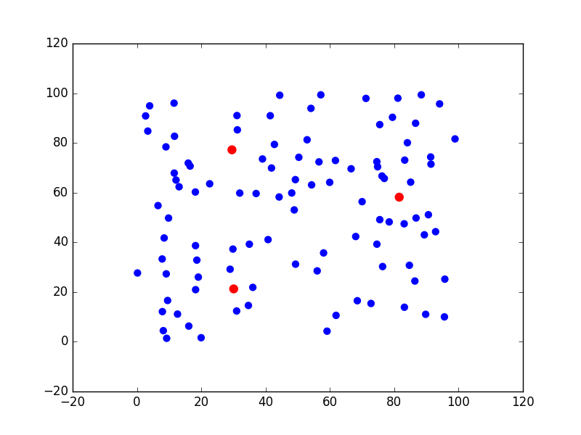
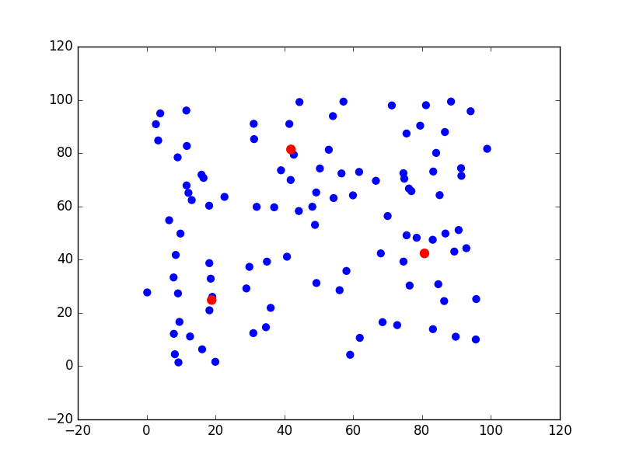

Experiment 1

Slide 7
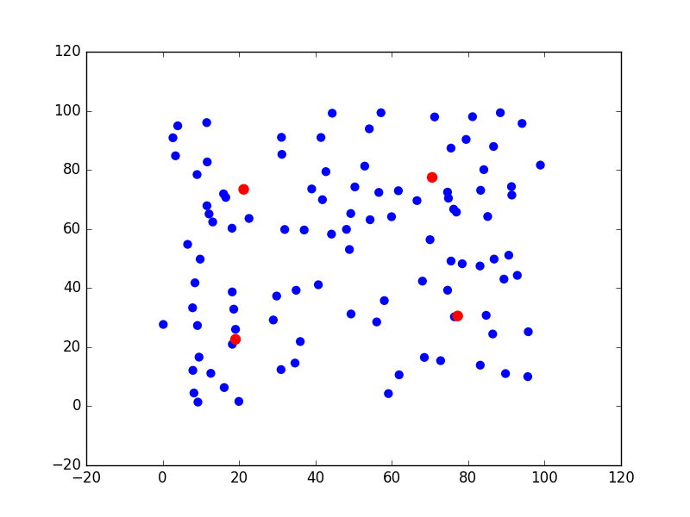



Experiment 1

Slide 8
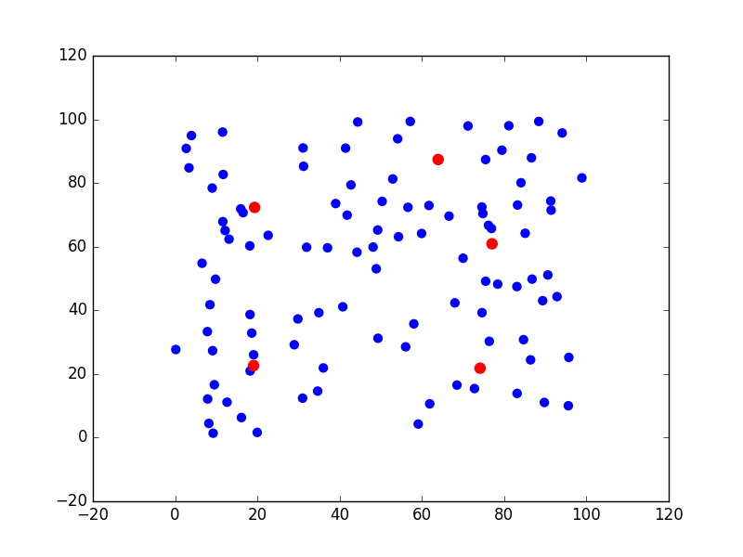
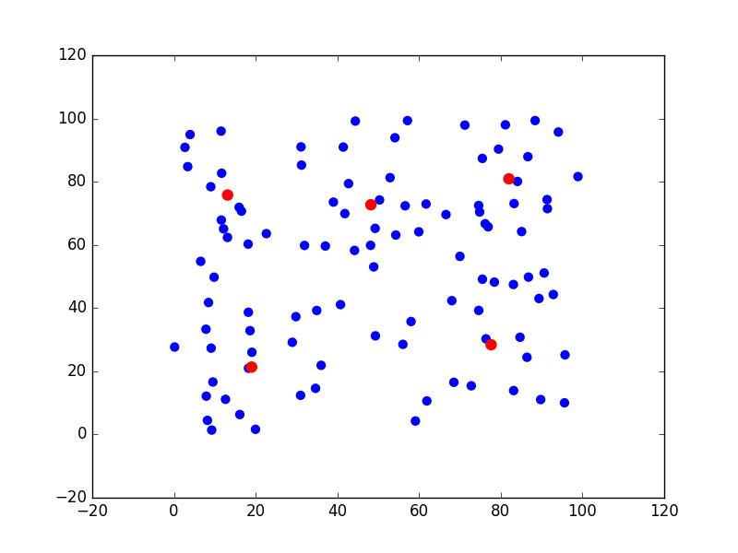
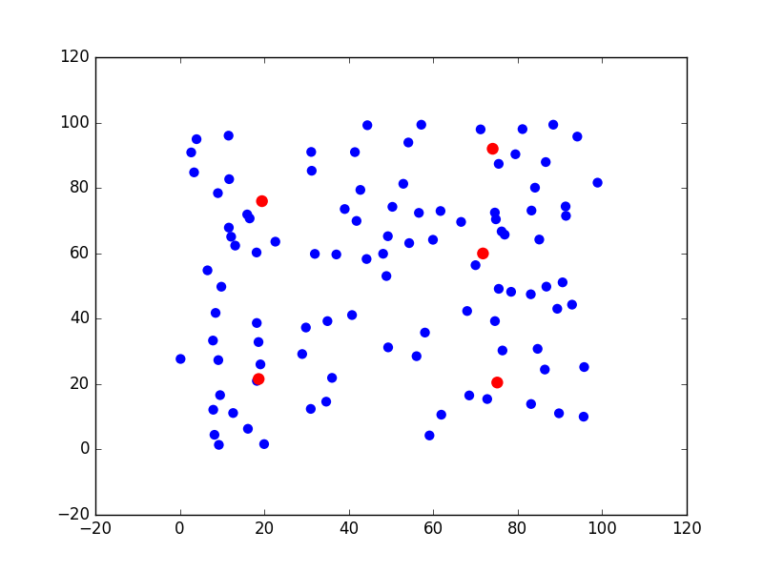
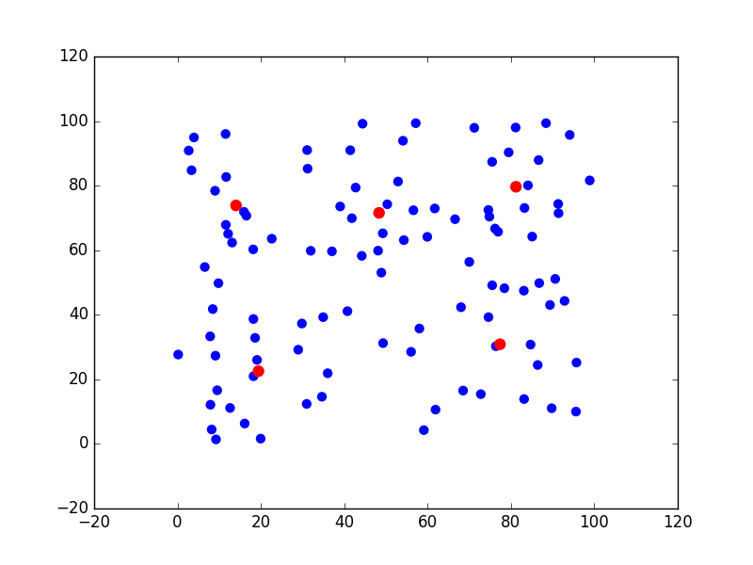
Experiment 1

Slide 9
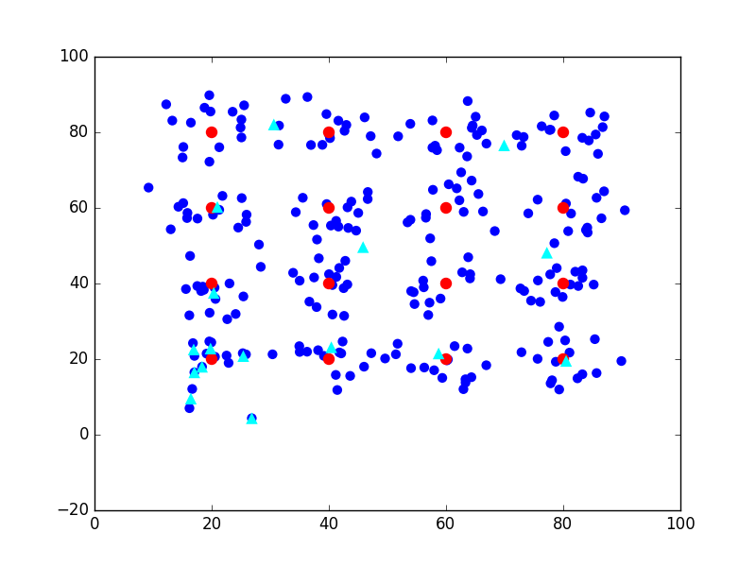
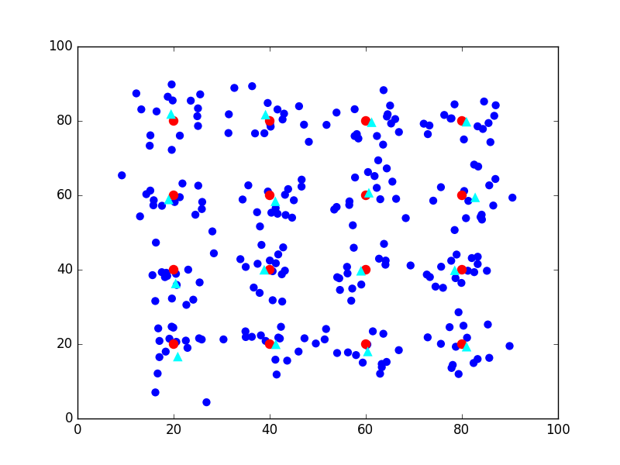
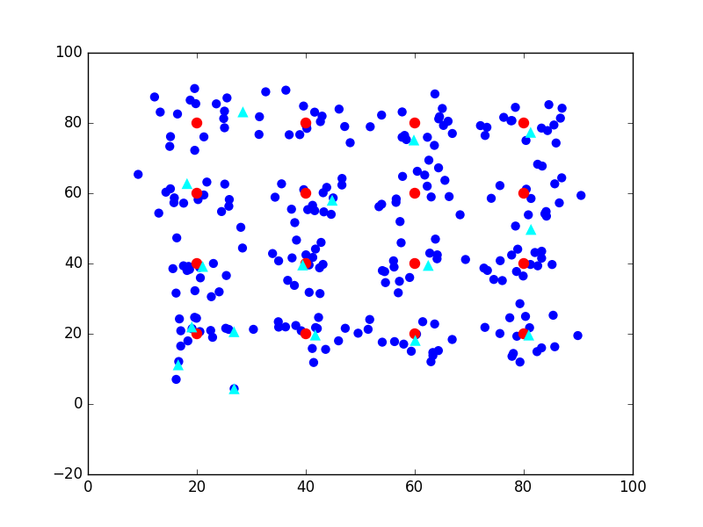
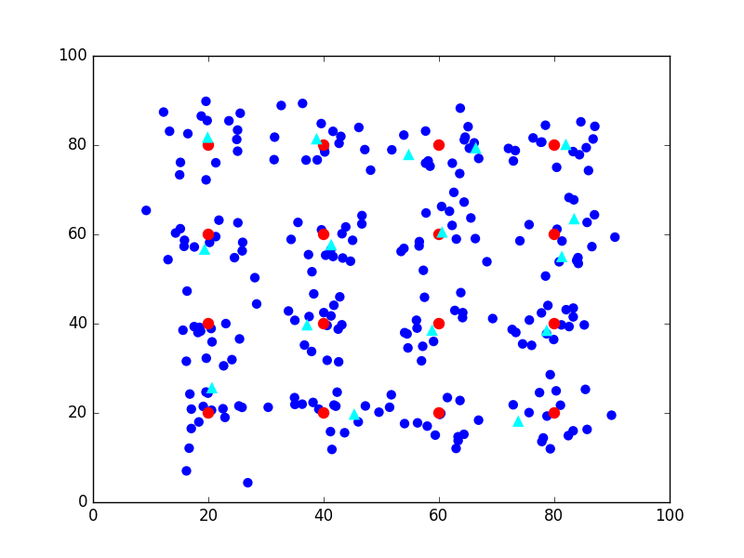
Experiment 2

Slide 10
Conclusions
In this lab, I implemented the algorithms using Java and then visualized the results using Python.
I Gained more experiences on clustering through this lab.
I Found that the k-Harmonic Means was much better than the others.
In the future, I’d like to improve and experiment more algorithms.

